Slide 1

TABLEAU PROJECT
CUSTOMER ANALYSIS DASHBOARD

Slide 2
Hello I’m Sumit Kumar Swain Data Analyst
In this project I analyse the data and create or build some dashboards for easily understand the data. First I analyse and create a ‘Customer Analysis Dashboard’.
In Customers Analysis Dashboard I creates charts to showcase the Customer’s data and solve problems.
All the details I present in this PPT.
Let’s begin the first step of our project that to know what is tableau and what is dashboard?

Slide 3
What is Tableau & What is Dashboard?
Definition: Tableau is a powerful data visualization tool used in the Business Intelligence (BI) industry. It helps users convert raw data into an understandable and interactive format using visuals like charts, graphs, and maps.
Key Features:
Drag-and-drop interface
Connects to various data sources (Excel, SQL, Google Sheets, etc.)
Real-time data analysis
Interactive dashboards and reports
Definition: A Dashboard in Tableau is a collection of multiple visualizations (like charts, graphs, and maps) displayed together on a single screen to give a complete overview of data.
Purpose:
To monitor performance metrics
To make data-driven decisions
To allow interactivity through filters and actions

Slide 4
Let’s Know The Data First And The Requirements.
I have a Dataset of Excel which I input in tableau public.
The Dataset name is Customer Analysis Data Source.
The requirements are :-
Revenue per state.
Revenue based on month of the year.
Revenue based on age.
Quantity – Discount percentage correlation.
Percentage of revenue per region.
Revenue per category per gender.
Build the Dashboard.

Slide 5
Now Import The Data And Create Charts. And Solve Requirements
Before go to the charts first we check the datatypes if any datatypes incorrect then it creates trouble for us in upcoming time.
So first change the datatypes if any requirement.
The Dataset have Customer sales, country, state, order date etc.
So now our first requirement is Revenue Based On State.

Slide 6
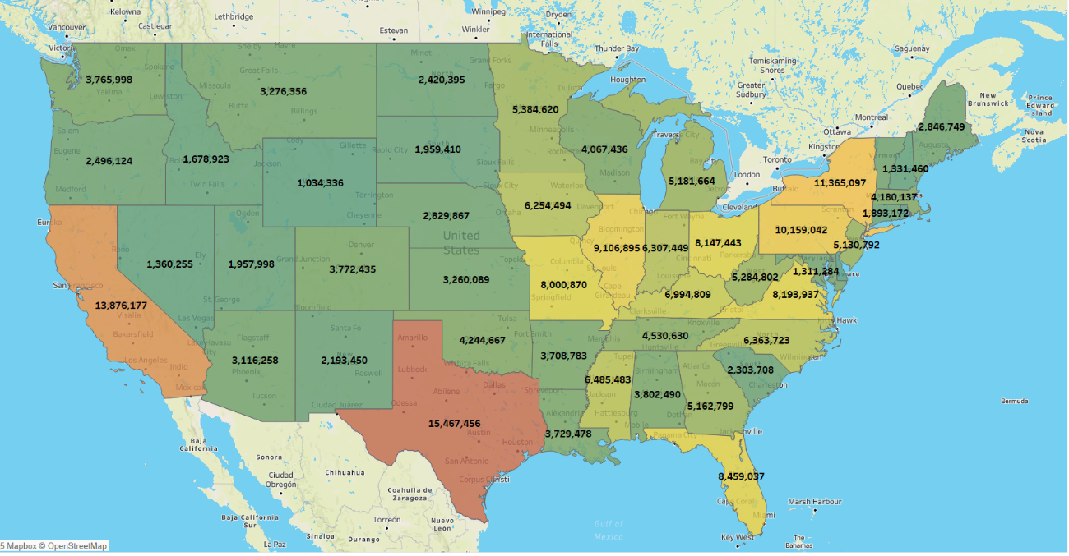
Revenue Based On State.
For this requirement I showcase the data in Geographical or Map chart.
Here I mentioned different state’s Revenue.
And for that double click the state.
Then drag and drop the total sales in the color and label.
Then our output is like this-

Slide 7
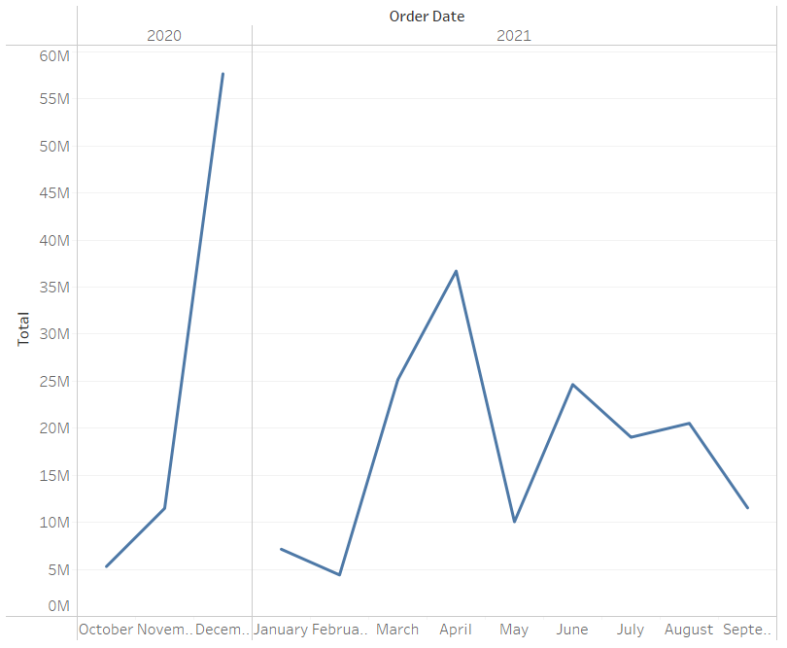
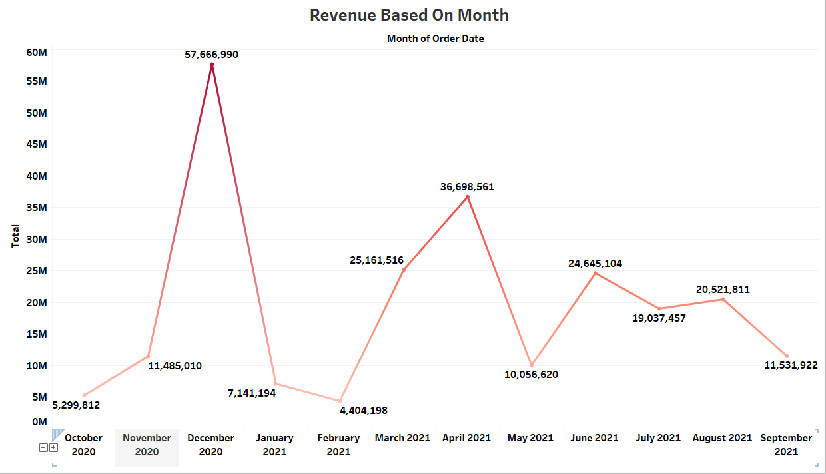
Revenue Based On The Month
Now 2nd requirement is revenue based on month. In this I am showing here that how the Revenue trends goes by time.
So we drag the order date and total sales or Revenue and create a line chart.
But if I add the month it doesn’t show the year and if I add year it gives two line chart because in our data the sales start from 2020 Oct to 2021 Sept.
So one thing we can do to convert it to month and click discrete.
(Before)
(After)

Slide 8
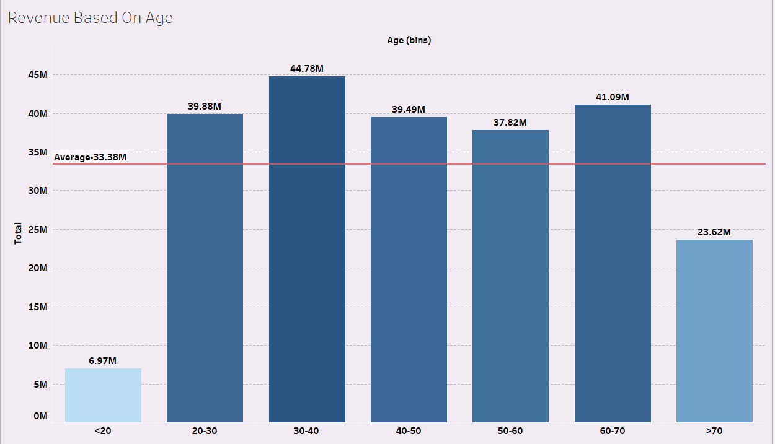
Revenue Based On Age.
Our 3rd requirement is revenue based on age.
For this I am creating a bar chart and showing that how the Revenue distributed by different age group.
And also mentioned the Average Revenue so that we can see that which age group cross it & which not.
The chart is –

Slide 9
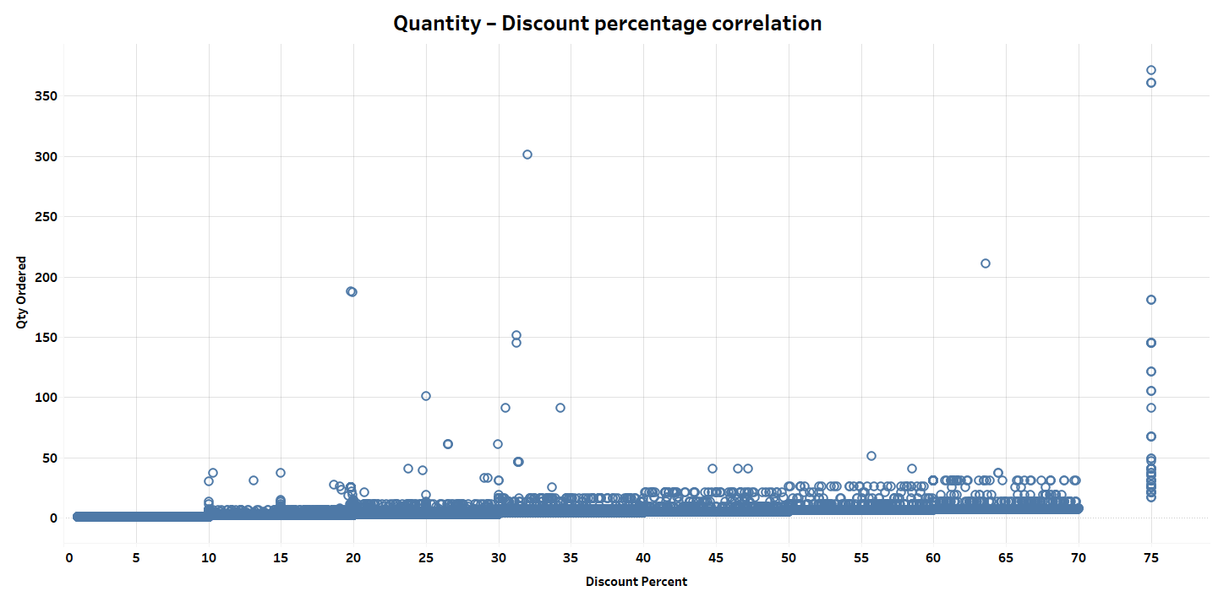
Quantity – Discount Percentage Correlation
So here we see the discount percentage how give affects to the quantity.
I create a Scatter plot to see the data easily.
Now you can see that when discount percentage increased the quantity of ordered also increased.
Also we can say that when the percentage of discount gets high the quantity of ordered goes to high as well.

Slide 10
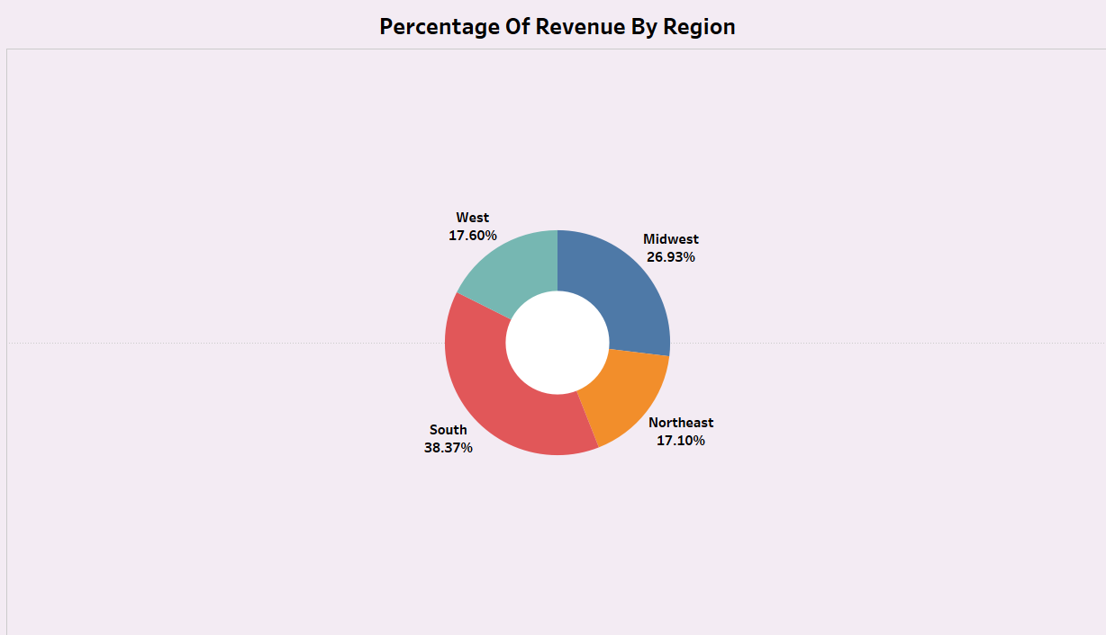
Percentage Of Revenue Per Region
Now Analyse the percentage of Revenue per region.
We see the details in donut chart.
Here you can see that which region high in Revenue.

Slide 11
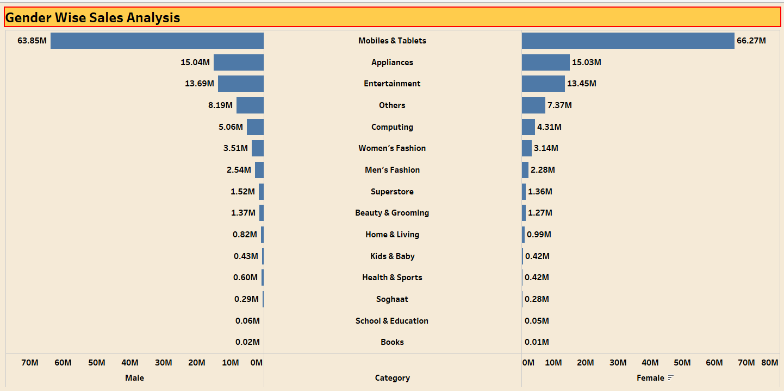
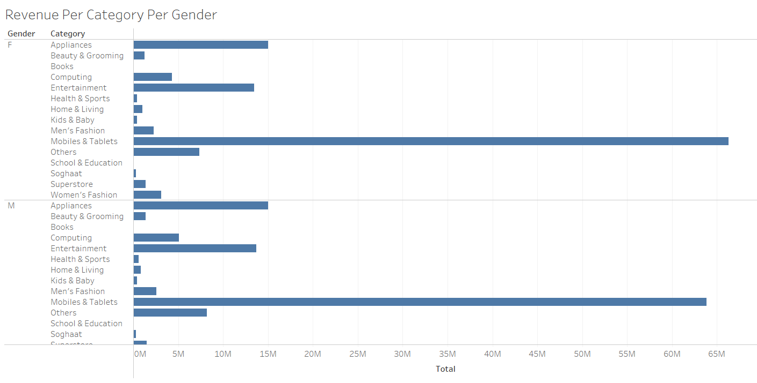
Revenue Per Category Per Gender.
Now we analyse the Revenue per category per gender.
Here we use the bar chart to show the analysis.
But when we drag and drop the gender and category with sales, the category will repeat twice because of gender.
So look of chart is very simple.
If we create a butterfly chart instead of the bar chart it looks beautiful in dashboard. And easily understandable also.

Slide 12
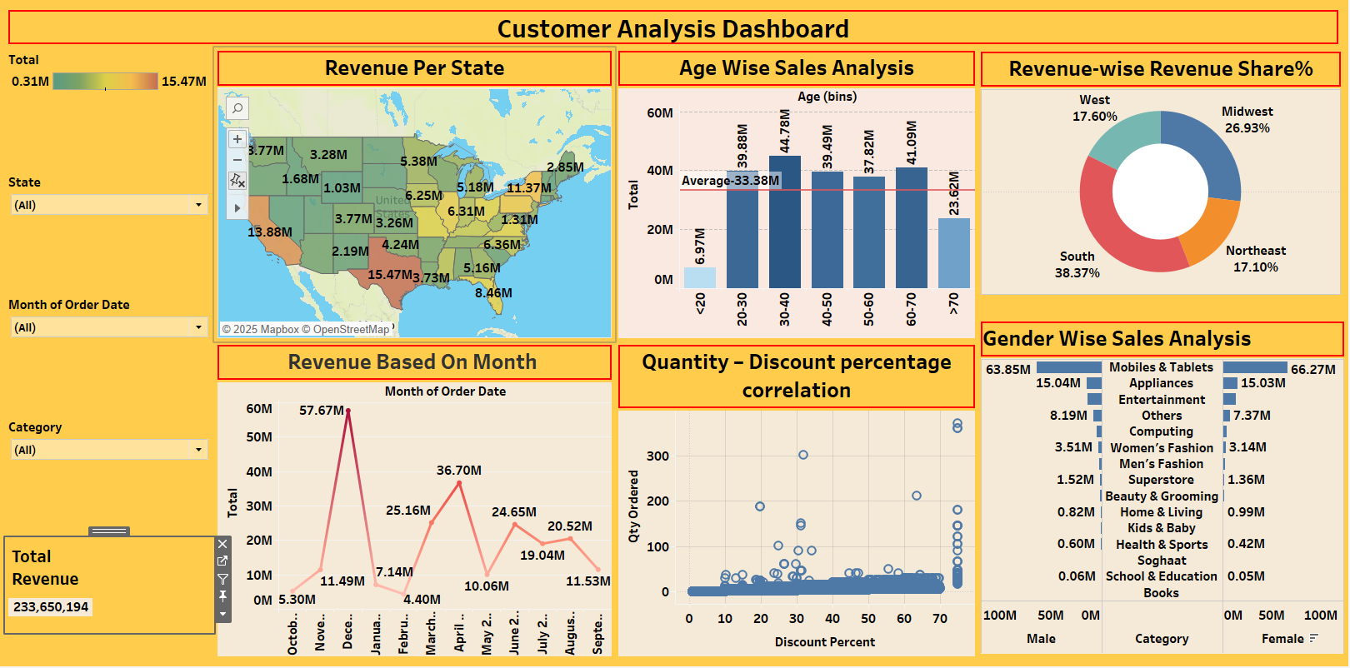
Customer Analysis Dashboard.
Now I create the Dashboard for quickly understand the analysis of Customer data.
In my dashboard I put all my charts and filters or legends for a quick view.
Here is the dashboard-

Slide 13
THANK YOU FOR WATCHING.
PROJECT DONE BY – SUMIT KUMAR SWAIN

